Slide 2
http://blog.minitab.com/blog/understanding-statistics/what-to-do-when-your-datas-a-mess2c-part-3

Slide 3
2 way anova without replication
Raw data from Page 359, Six Sigma Handbook
Prepare pattern data
Data/Stack/Column
Stat/ANOVA/Generalized linear model/Fit GLM

Slide 4
Factorial Design

Slide 5
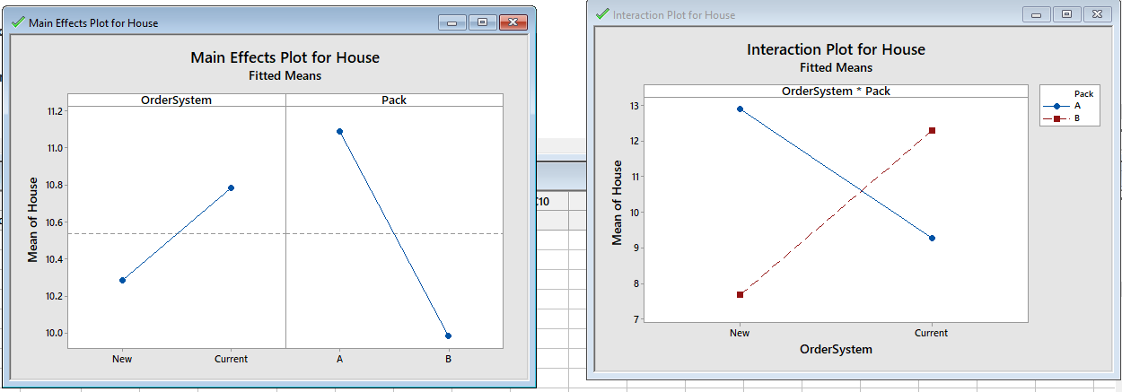

Slide 6
Response surface

